Slide 1
Pathology of exocrine pankreas
MUDr. Miroslav Koblížek

Slide 2
Schedule
Congenital anomalies
Cystic fibrosis
Inflammation
Acute pancreatitis
Chronic pancreatitis
Tumors

Slide 3
Schedule
Congenital anomalies
Cystic fibrosis
Inflammation
Acute pancreatitis
Chronic pancreatitis
Tumors

Slide 4
Congenital anomalies
Pancreas divisum
Annular pancreas
Pancreas agenesis
Congenital pancreatic cysts
Pancreatic heterotopia

Slide 5
Congenital anomalies
Embryology recapitulation
-> pancreas divisum, annular pancreas

Slide 6
Congenital anomalies
Pancreas divisum
incomplete fusion or two completely separate structures
partial obstruction of ducts -> predisposition for recurrent pancreatitis
Annular pancreas
may cause partial stenosis of duodenum
frequently associated with Down syndrome

Slide 7
Congenital anomalies
Pancreas agenesis
rare
often associated with other malformations incompatible with life
Pancreatic cysts
may be associated with other syndromes like AD polycystic kidney disease

Slide 8
Congenital anomalies
Pancreatic heterotopia
presence of pancreatic tissue in GIT
stomach
duodenum
jejunum
Meckel diverticulum
rarely can cause mucosal bleeding or inflammation
in biopsy - do not confuse with metaplasia or neoplasm

Slide 9
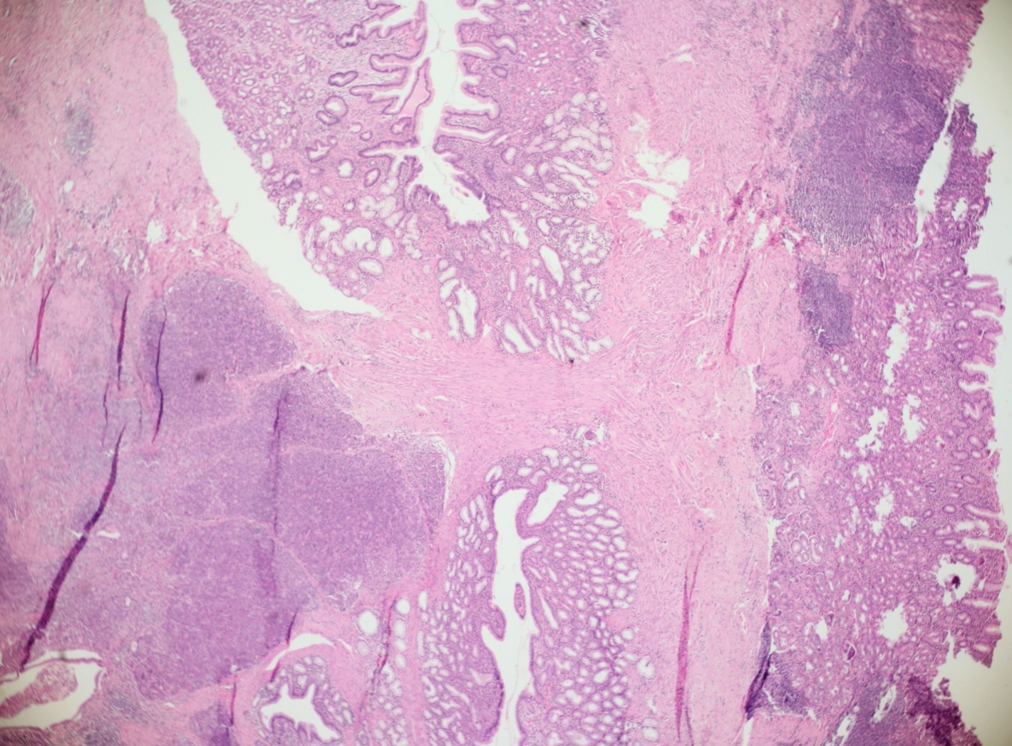
Congenital anomalies
Pancreatic heterotopia

Slide 10
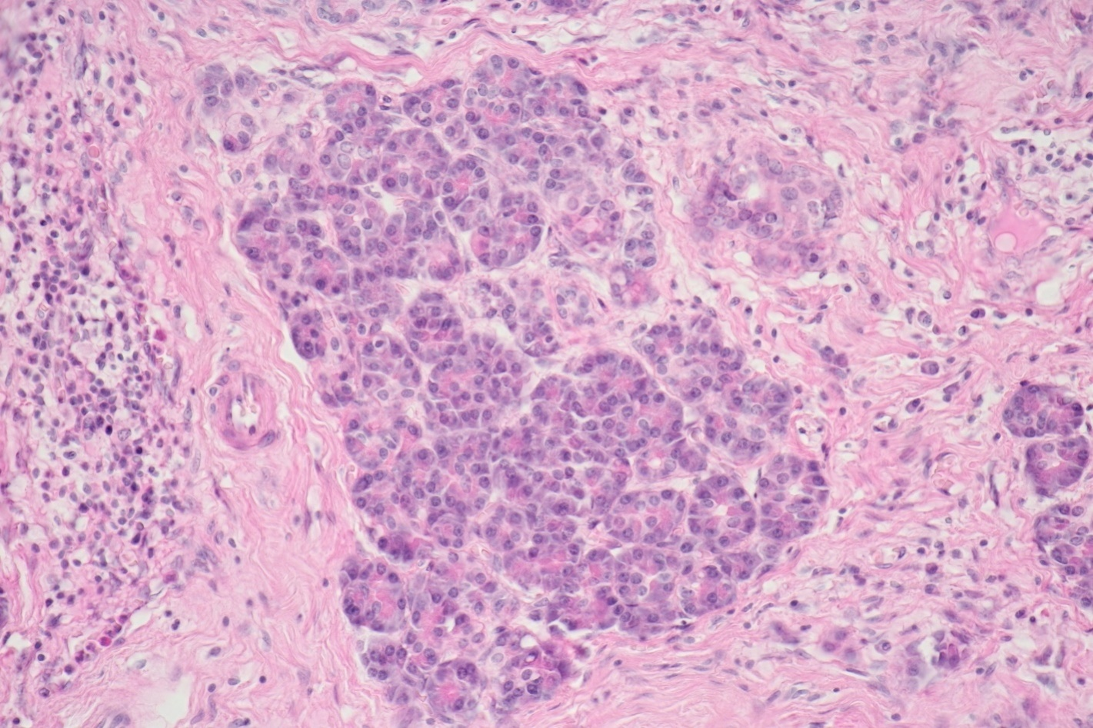
Congenital anomalies
Pancreatic heterotopia

Slide 11
Schedule
Congenital anomalies
Cystic fibrosis
Inflammation
Acute pancreatitis
Chronic pancreatitis
Tumors

Slide 12
Cystic fibrosis (mucoviscidosis)
AR disease
incidence – 1/2500
mutation of CFTR gene

Slide 13
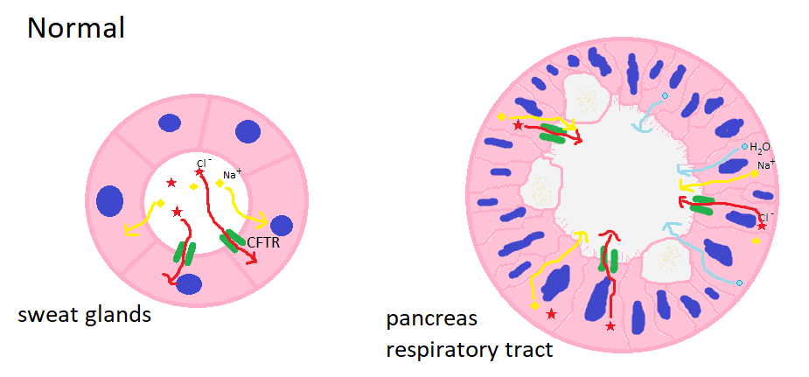
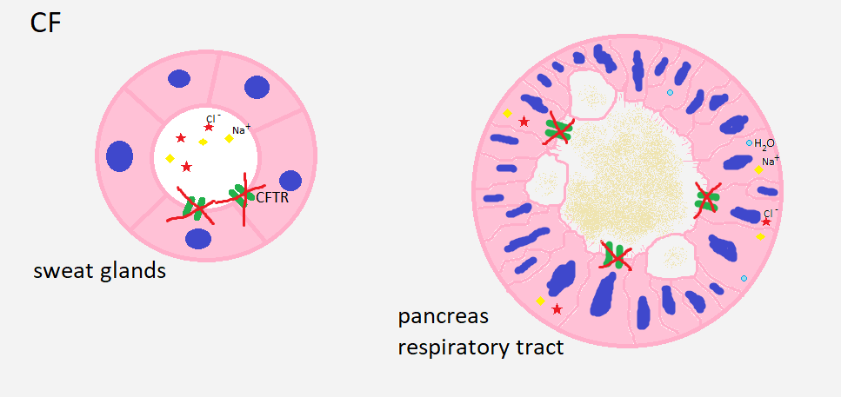
Cystic fibrosis

Slide 14
Cystic fibrosis
Pancreas
accumulation of hyperconcentrated mucus ->
-> duct obstruction and cystic dilation ->
-> atrophy of exocrine pancreas ->
-> fibrosis of stroma
islets of Langerhans remains relatively intact,
in severe cases numeric reduction -> diabetes mellitus

Slide 15
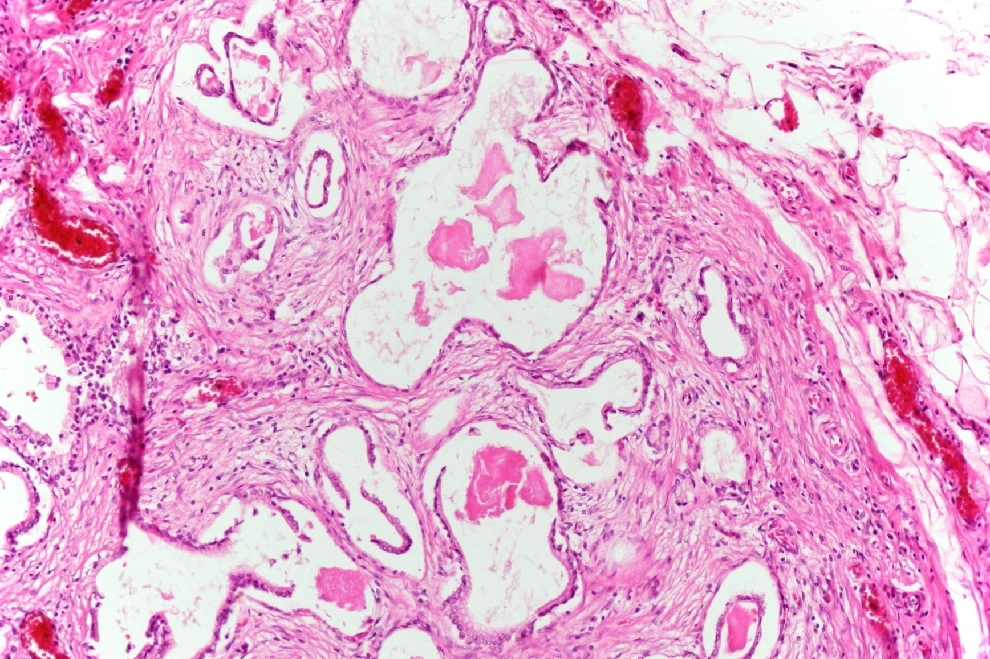
Cystic fibrosis

Slide 16
Cystic fibrosis
Pancreas
deficiency of pancreatic enzymes ->
-> steatorhea
-> malabsorption of vitamins
-> supplements of pancreatic enzymes

Slide 17
Cystic fibrosis
Lungs
clinically most important
bacterial overgrowth in stagnating mucus ->
-> recurrent infections ->
-> obstruction lung disease and cor pulmonale chronicum
-> airways rehabilitation -> lung transplantation

Slide 18
Cystic fibrosis
Other complications
GIT – meconium ileus of newborns
bile ducts – stagnation and biliary cirrhosis
salivary glands – mucus stagnation, atrophy and fibrosis
azoospermia and infertility

Slide 19
Schedule
Congenital anomalies
Cystic fibrosis
Inflammation
Acute pancreatitis
Chronic pancreatitis
Tumors

Slide 20
Acute pancreatitis
autodigestion of pancreas and peripancreatic tissues by pathologically activated pancreatic enzymes ->
-> systemic inflammatory response

Slide 21
Acute pancreatitis
Etiopathogenesis
normal function
proenzymes activated by trypsin
trypsinogen secerned by pancreatic acinar cells is activated into trypsin in duodenum
protease inhibitors in pancreatis secret

Slide 22
Acute pancreatitis
Etiopathogenesis
pathology
obstruction of ducts -> ↑intraductal pressure -> ischemic injury of pancreatic acinar cells
CHOLELITHIASIS
tumor
congenital anomaly

Slide 23
Acute pancreatitis
Etiopathogenesis
pathology
obstruction of ducts -> ↑intraductal pressure -> ischemic injury of pancreatic acinar cells
primary injury of pancreatic acinar cells
toxins - ALCOHOL
ischemia
trauma
infection
…

Slide 24
Acute pancreatitis
Etiopathogenesis
pathology
obstruction of ducts -> ↑intraductal pressure -> ischemic injury of pancreatic acinar cells
primary injury of pancreatic acinar cells
primary defect of intracellular transport -> protease activation in lysosomes

Slide 25
Acute pancreatitis
Etiopathogenesis
activated enzymes
proteases -> parenchyma destruction -> release of more enzymes -> chain reaction
lipases -> necroses of adipose tissue = Balser necroses -> precipitation of calcium -> hypocalcemia
phospholipase -> ARDS
elastases -> destruction of vessel wall -> bleeding

Slide 26
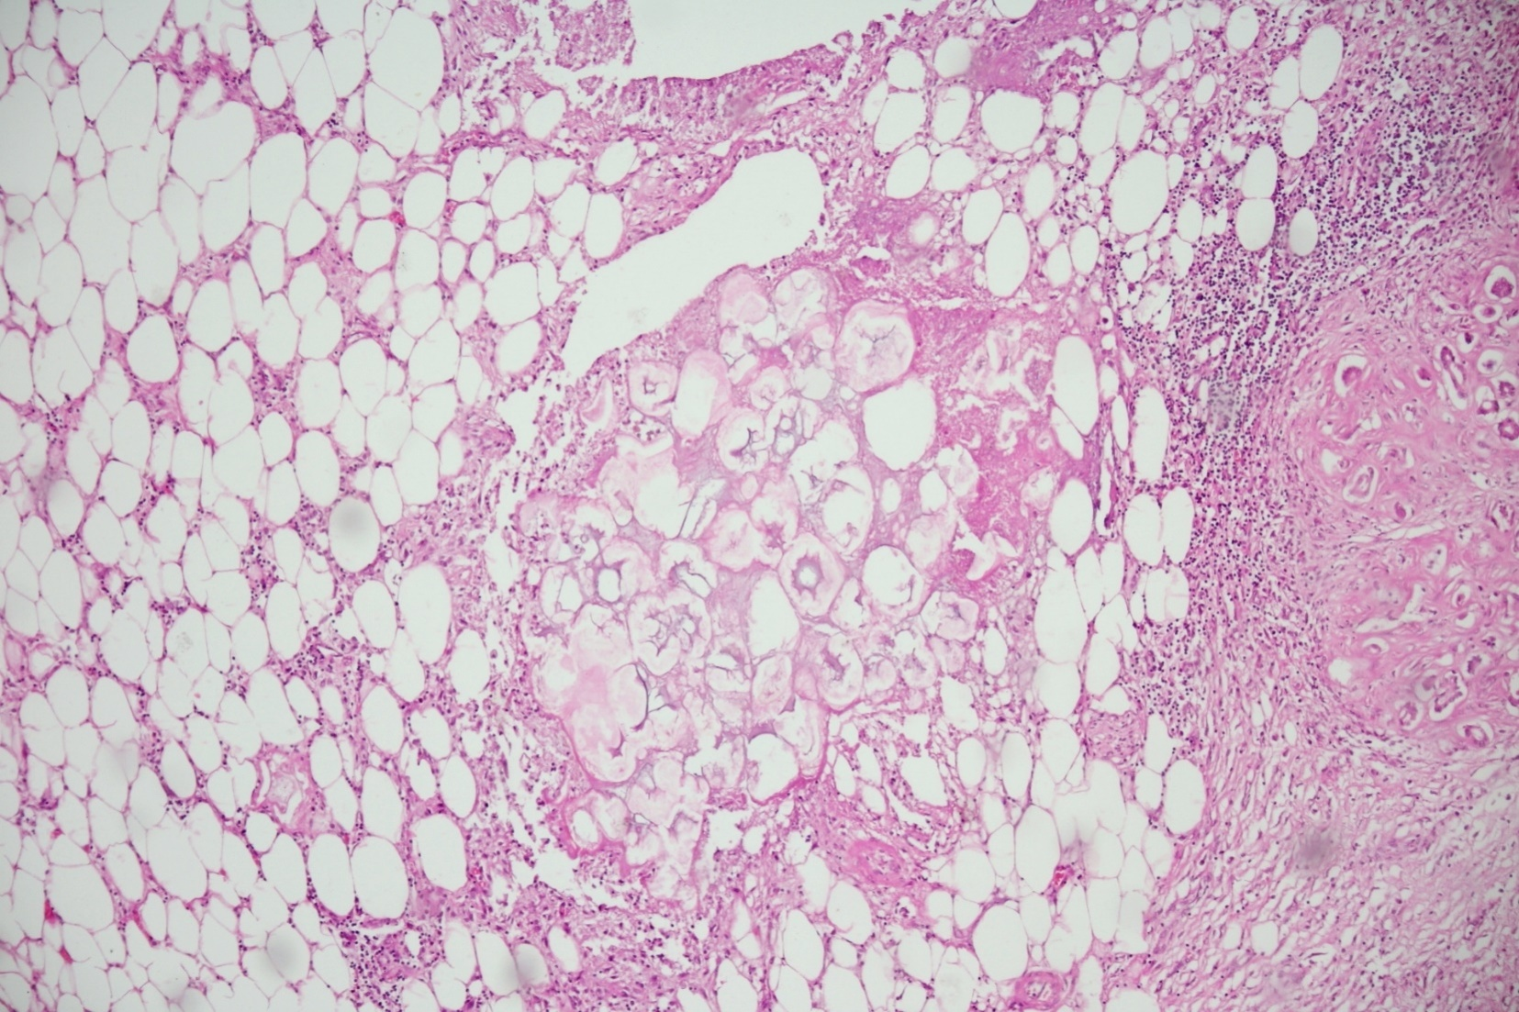
Acute pancreatitis
Balser necrosis

Slide 27
Acute pancreatitis
Morphology
acute intersticial pancreatitis
mild form
intersticial oedema
focal necroses of adipose tissue

Slide 28
Acute pancreatitis
Morphology
acute intersticial pancreatitis
acute necrotizing pancreatitis
necroses of parenchyma
frequent Balser necroses – even in other sites
exssudate in peritoneal cavity

Slide 29
Acute pancreatitis
Morphology
acute intersticial pancreatitis
acute necrotizing pancreatitis
hemorrhagic pancreatitis
most severe – 30% letality
large hemorrhages
necrosis of almost whole pancreas
infection
posthemorrhagic pseudocyst

Slide 30
Acute pancreatitis
Symptomes and systemic response
acute continuous abdominal pain
shock
ARDS
DIC
laboratory - ↑amylases and lipases

Slide 31
Schedule
Congenital anomalies
Cystic fibrosis
Inflammation
Acute pancreatitis
Chronic pancreatitis
Tumors

Slide 32
Chronic pancreatitis
chronic inflammation or recurrent attacs of acute pancreatitis ->
-> destruction of acinary cells ->
-> fibrosis of exocrine pancreas
- islets are spared
morphology – fibrosed focus in pancreas – do not confuse with carcinoma

Slide 33
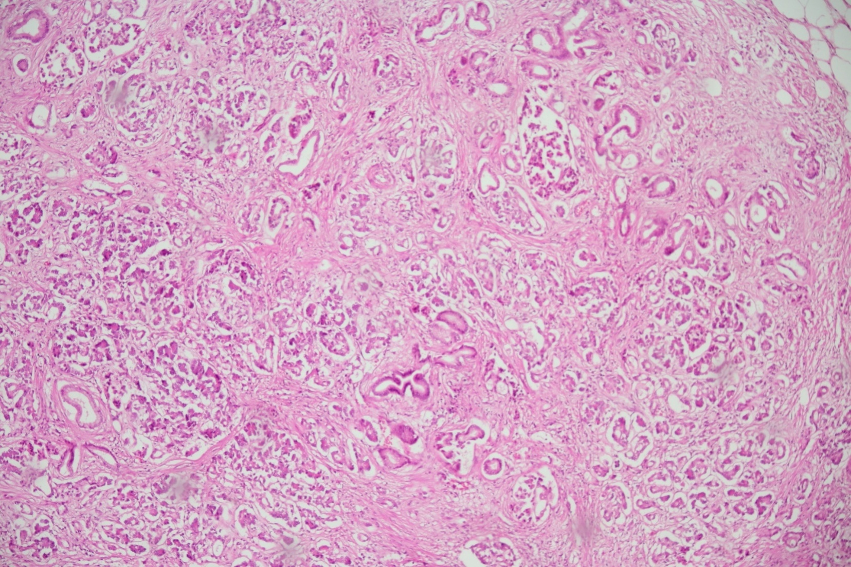
Chronic pancreatitis
Fibrosis of stroma, distortion of ducts

Slide 34
Chronic pancreatitis
Etiopathogenesis
toxic/metabolic – alcohol, nicotine, some drugs
idiopatic
genetic – mutations of gene for trypsin or alpha-1-antitrypsin
autoimmune – type 1 – IgG4 related; type 2 – isolated
recurrent
obstructive

Slide 35
Chronic pancreatitis
Subtypes
chronic alcoholic
dilation of ducts -> stagnation of content – mucoprotein plugs -> calcification
paraduodenal pancreatitis
associated with pancreatic duct abnormalities
cause duodenal obstruction
recurrent attacks
hereditary chronic pancreatitis
AD – mutation of trypsinogen-1 gene
AR – mutation of trypsin inhibitor

Slide 36
Chronic pancreatitis
Subtypes
autoimmune
IgG4 associated
idiopathic
treated with corticoids
chronic obstructive
chronic obstruction by tumor, pseudocyst or fibrous stricture
no mucoprotein plugs, no pseudocysts

Slide 37
Chronic pancreatitis
Clinical appearance
chronic abdominal pain – propagation to back
reccurent acute exacerbations – chronic alcoholic, paraduodenal or hereditary pancreatitis
weight loss
obstructive icterus – when situated in head of pancreas

Slide 38
Schedule
Congenital anomalies
Cystic fibrosis
Inflammation
Acute pancreatitis
Chronic pancreatitis
Tumors
Carcinoma of pancreas
precursor lesions
Cystic tumors

Slide 39
Tumors
Ductal adenocarcinoma of pancreas
85 % of all pancreatic tumors
Intraductal papillary mucinous neoplasia (IPMN)
Mucinous cystic neoplasia
Serous cystadenoma
Acinary cell carcinoma
Solid pseudopapilary tumor of pancreas
…
Tumors from islet cells

Slide 40
Ductal adenocarcinoma
poor prognosis – 5year survival – only 5 %
4.-5. most frequent cause of death from neoplasms
older patients (60-80 years)
frequently generalised in time of diagnosis
more frequent in head of pancreas than in tail

Slide 41
Ductal adenocarcinoma
Pancreatic intraepithelial neoplasia (PanIN) – precursor
low-grade PanIN
KRAS activation
CDKN2A inactivation
high-grade PanIN
TP53 inactivation
DPC4/SMAD4 fusion

Slide 42
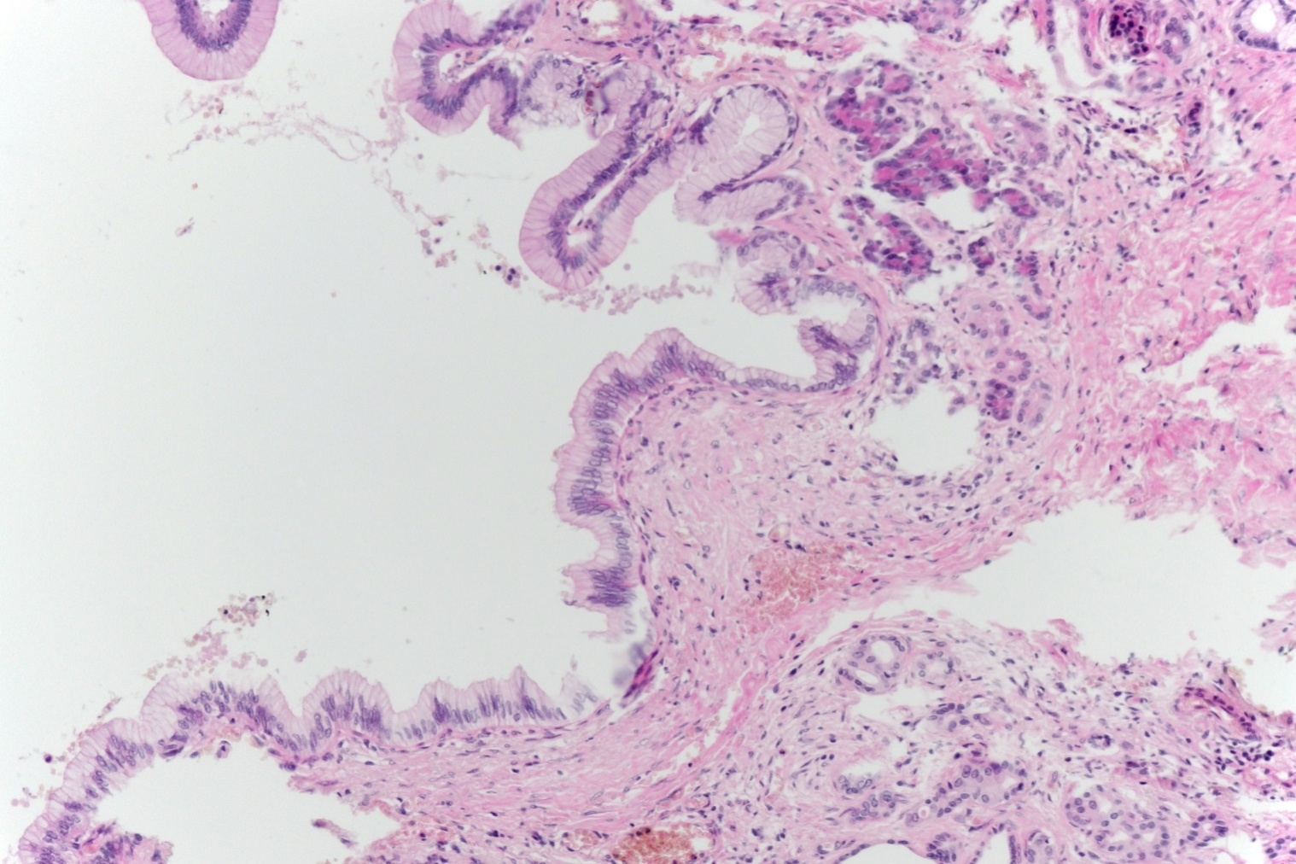
Ductal adenocarcinoma
low-grade PanIN

Slide 43
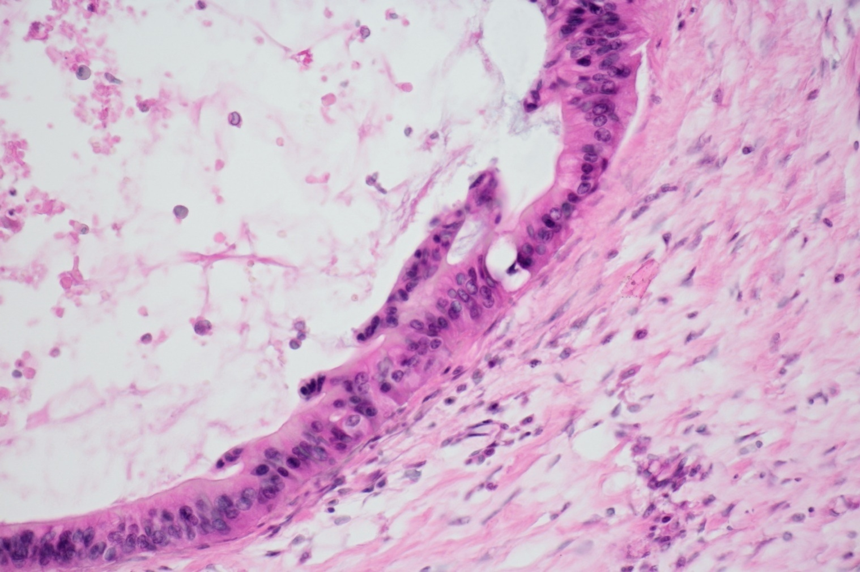
Ductal adenocarcinoma
high-grade PanIN

Slide 44
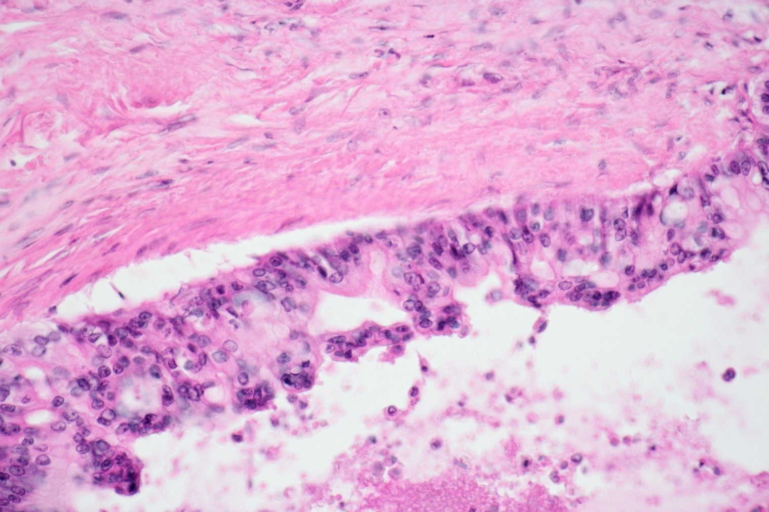
Ductal adenocarcinoma
high-grade PanIN

Slide 45
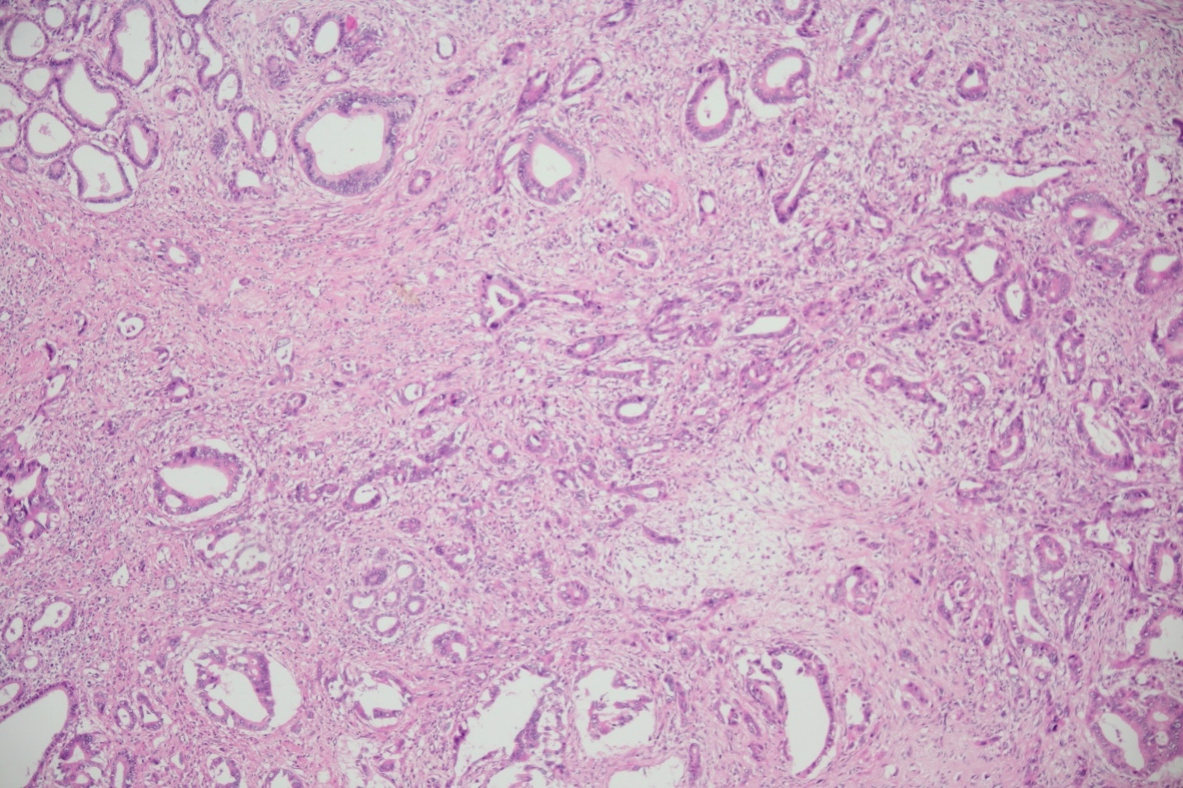
Ductal adenocarcinoma
invasive ductal adenocarcinoma

Slide 46
Ductal adenocarcinoma
perineural invasion

Slide 47
Ductal adenocarcinoma
invasive growth to retroperitoneum
perineural invasion in almost all cases – complicated radical resection
lymph node metastases
later hemathogenic metastases to liver, lungs…

Slide 48
Ductal adenocarcinoma
Clinical symptomes
sudden painless icterus – due to obstruction of choledochus
nonspecific symptoms
abdominal dyscomfort and pain
weight loss
deep vein thromboses

Slide 49
Cystic tumors
Intraductal papillary mucinous neoplasia (IPMN)
in head of pancreas, in older men
papillary proliferation in dilated duct
possible progression to ductal adenocarcinoma
Mucinous cystic neoplasia
almost exclusively in women
cysts without communication with ductal system
possible progression to ductal adenocarcinoma
Serous cystadenoma
usually benign

Slide 50
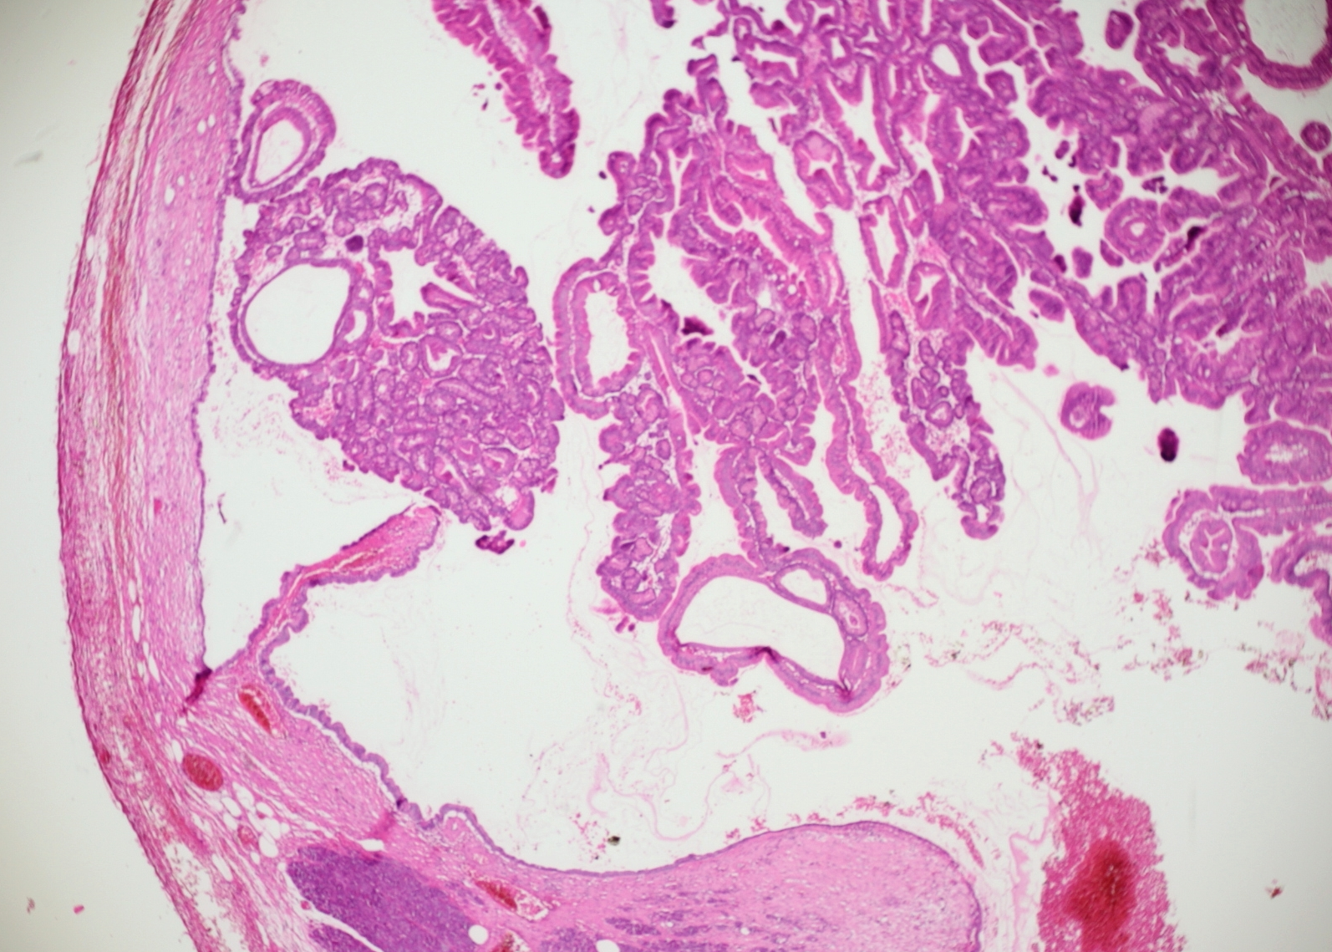
Intraductal papillary mucinous neoplasia (IPMN)

Slide 51
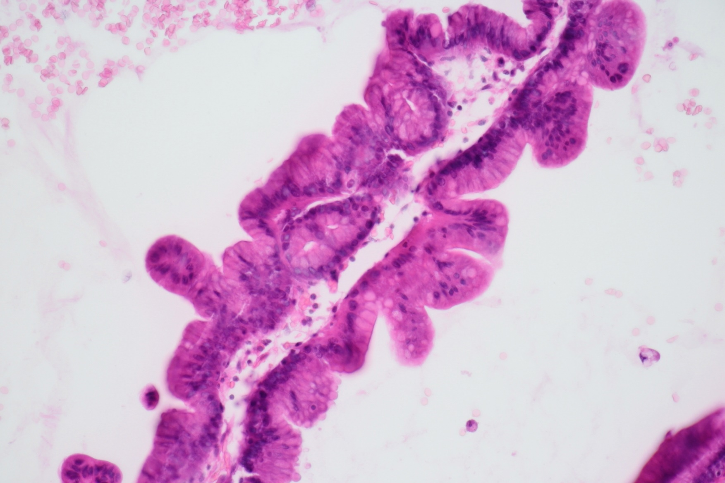
Intraductal papillary mucinous neoplasia (IPMN)

Slide 52
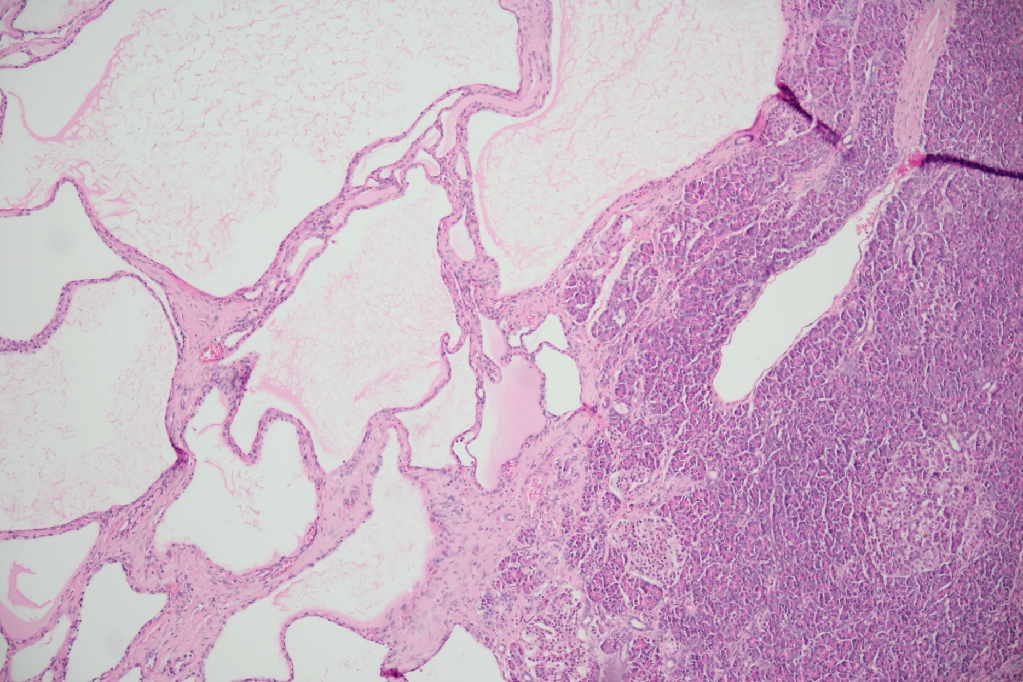
Serous cystadenoma

Slide 53
Solid pseudopapillary tumor of pancreas
young patients < 40 years
almost 1/3 of pancreatic tumors in this age group
low malignant potential
well demarcated, resecable

Slide 54
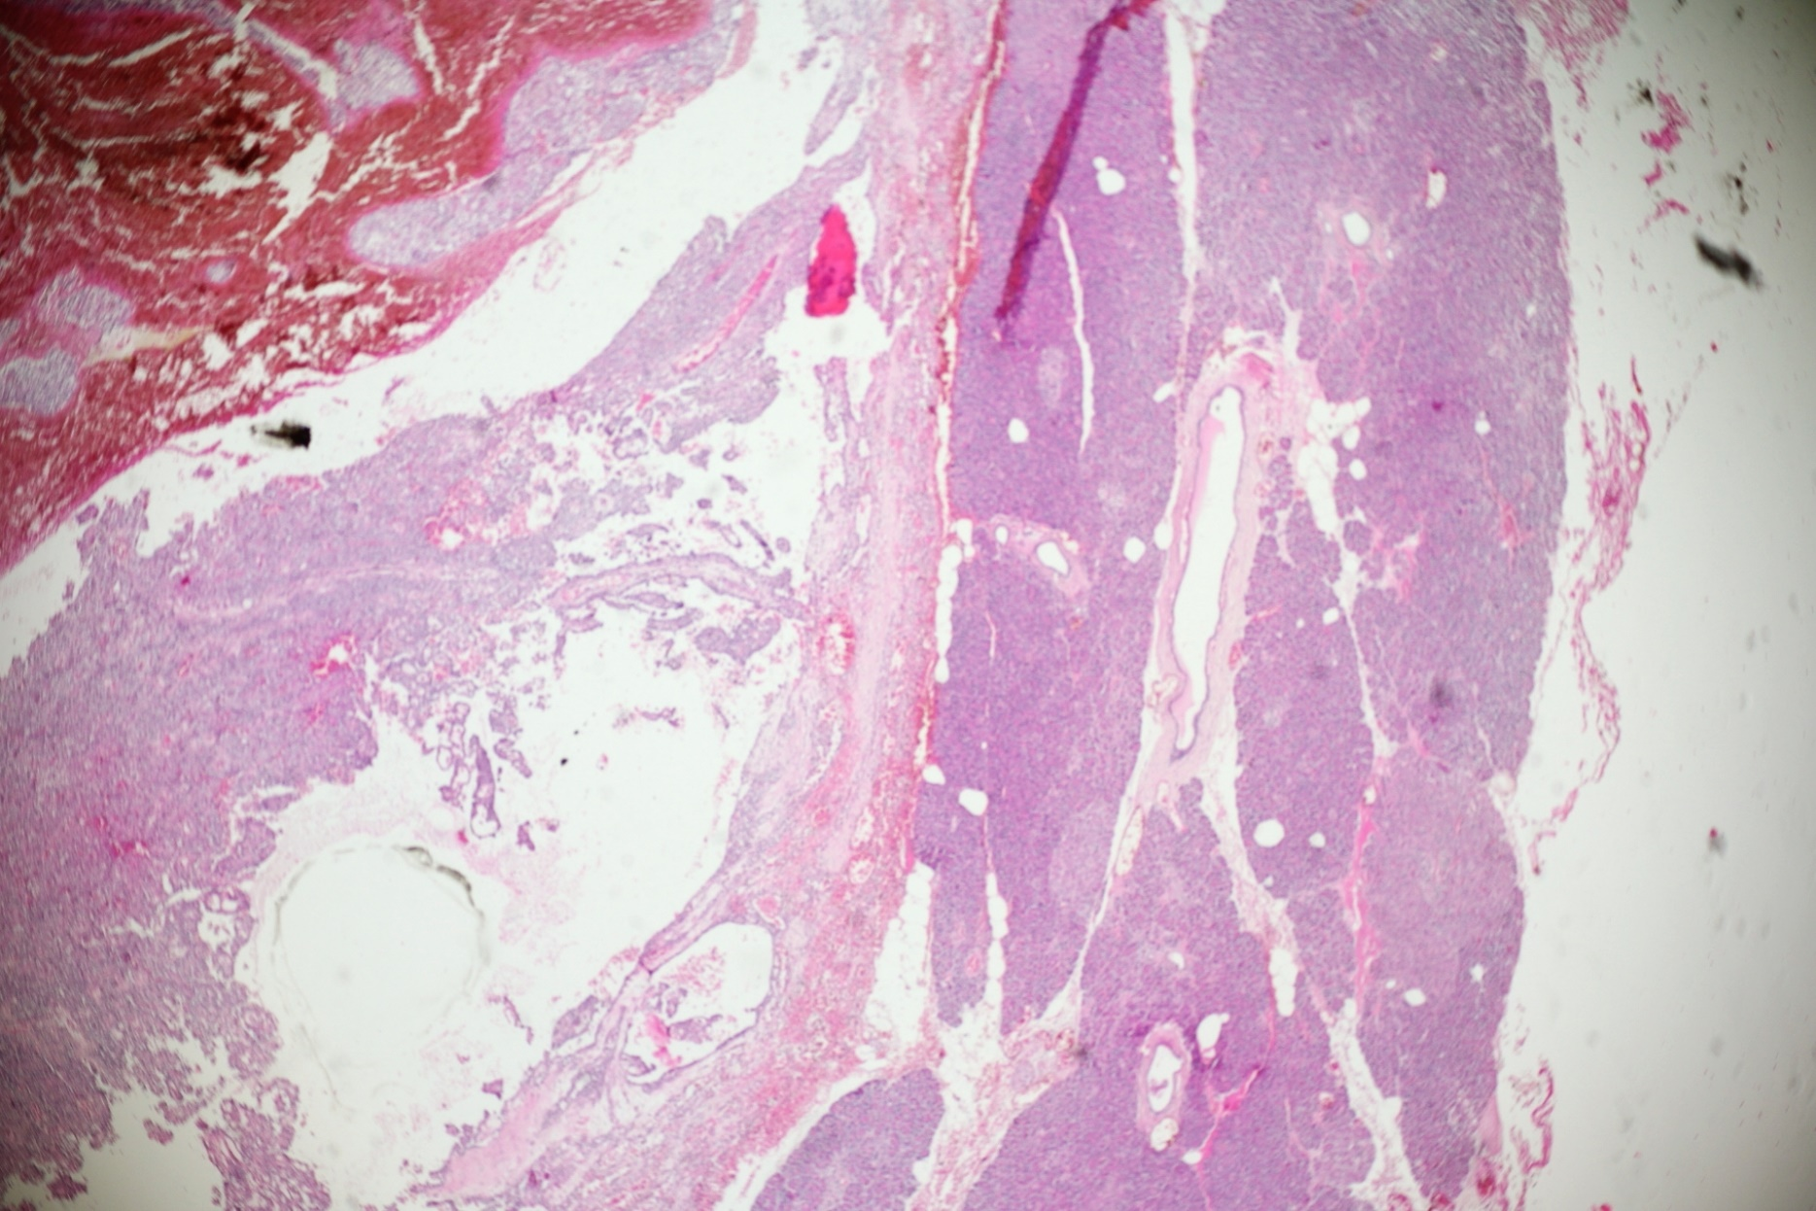
Solid pseudopapillary tumor of pancreas

Slide 55
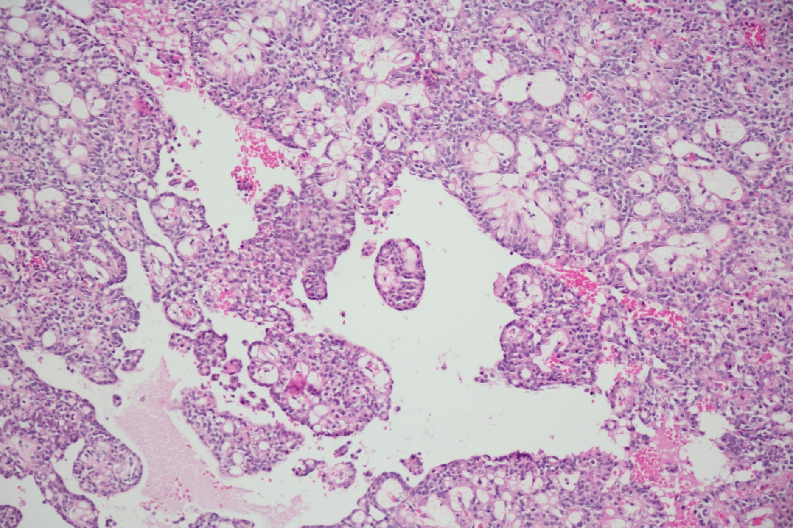
Solid pseudopapillary tumor of pancreas

Slide 56
Acinary cell carcinoma
agressive tumor
in younger patients
expression of pancreatic exocrine enzymes

Slide 57
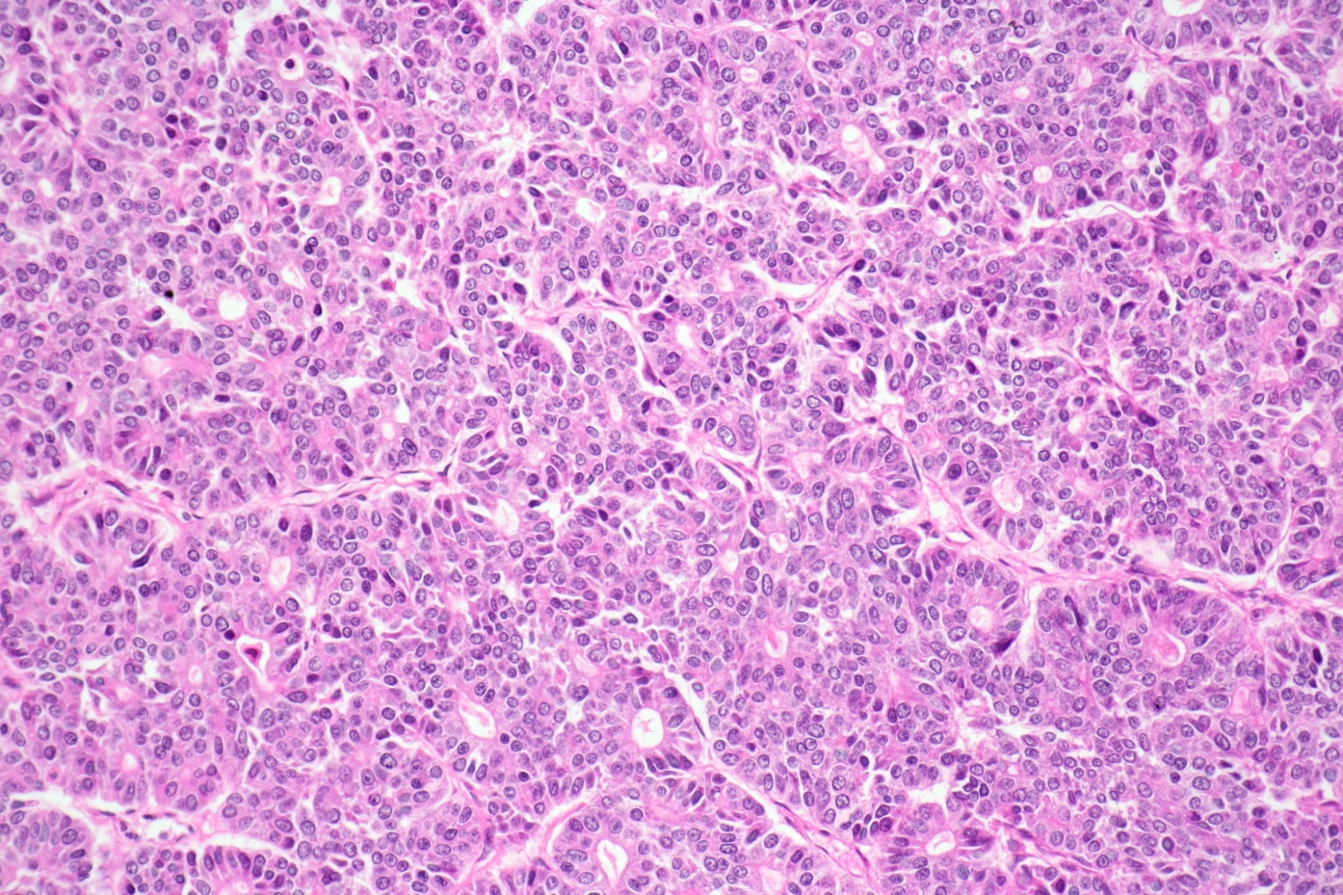
Acinary cell carcinoma

Slide 58
Tumors
Tumors from islet cells - nesidiomas
usually benign
usually small
usually hormonally active -> endocrinopathy
insulinoma -> hypoglycemia
gastrinoma -> Zollinger-Ellison syndrome
VIPoma

Slide 59
thank you for your attention

